Slide 1

CAPSTONE PROJECT - UNIVERSITY SUCCESS ANALYSIS
NAME - SHOUVIK DE

Slide 2
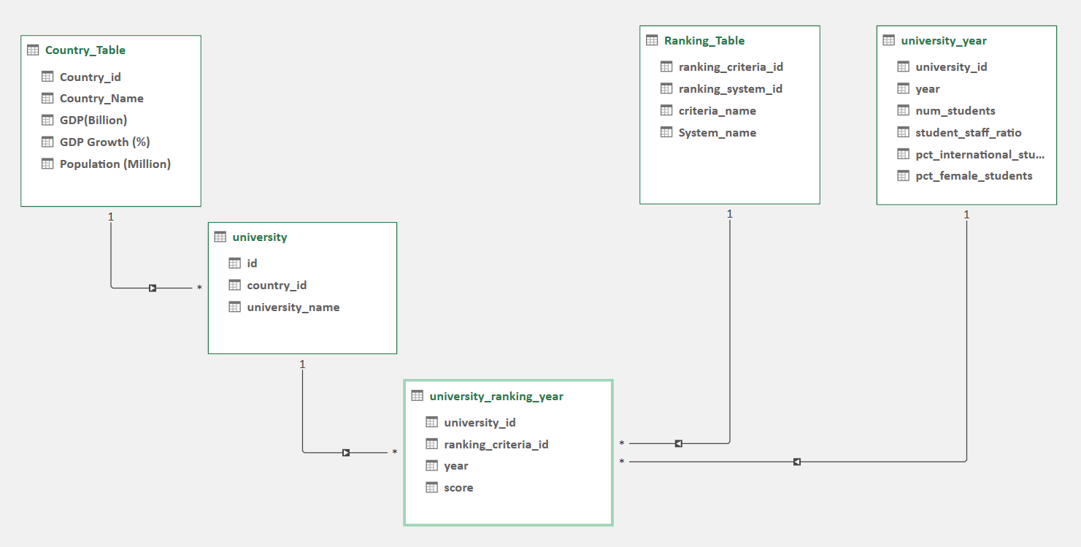
Data Model In Excel

Slide 3
Data Dictionary
id (Primary Key): Unique identifier for records in various tables.
country_name: Name of the country where the university is located.
ranking_system_id: Identifier for the ranking system used for university rankings.
criteria_name: Name of the criteria used for ranking universities.
system_name: Name of the ranking system.
country_id (Foreign Key): Identifier linking universities to their respective countries.
university_name: Name of the university.
university_id (Primary Key): Unique identifier for universities.
ranking_criteria_id (Primary Key): Unique identifier for ranking criteria.
year: The year for which the ranking or performance data is reported.
score: The score assigned to the university based on ranking criteria.
num_students: Number of students enrolled in the university.
student_staff_ratio: Ratio of students to staff members in the university.
pct_international_students: Number of international students in the university.
pct_female_students: Number of female students in the university.

Slide 4
EDA PROBLEM STATEMENT
Q. Is there a correlation between a country's GDP and the number of universities?
Correlation – 0.907
Conclusion – It is showing that it has a positive correlation between Countries GDP and Number of University. The higher GDP has the higher number of University.

Slide 5
Q. Is there a relationship between a country's population and the number of universities?
Correlation - 0.3264
Conclusion – Correlation between population and number of universities are not dependent strongly, but we can see the less number of populations have less number of universities.

Slide 6





Q. Are there any common criteria used by different ranking systems?
Average of score | Column Labels
Row Labels | 1 | 2 | 3
Harvard University | 82 | 96 | 14
University of Cambridge | 86 | 70 | 25
University of California, Berkeley | 80 | 69 | 21
Stanford University | 85 | 68 | 17
California Institute of Technology | 90 | 65 | 47
Princeton University | 86 | 59 | 48
Columbia University | 84 | 59 | 21
University of Chicago | 82 | 56 | 39
University of Oxford | 90 | 55 | 22
Yale University | 78 | 53 | 29
Conclusion - Here we can see the better of ranking criteria that university are well known for studies and research.

Slide 7
Q. How does the choice of ranking system affect a university's international student enrolment?
Correlation : - 0.0936
Conclusion – International student admission are not dependent on University Ranking.

Slide 8
Q. Is there a relationship between a university's score and the student-staff ratio?
Correlation : 0.1768
Conclusion – Though correlation between Student-Staff ratio is not strong, but we can see that less number of student staff ratio the more scored have that university.

Slide 9
Q. How does the number of female students differ among universities?
Correlation: - 0.0146
Conclusion – We can see the better number of university ranking has the more number of female students have.

Slide 10
Q. What is the trend in the percentage of female students over time?

Slide 11
Q. Is there a relationship between a university's ranking score and the number of students over time?
Correlation : -0.0699
Conclusion – Though number of students and score has not strong correlation, but we can see the less number of students has in university the less scored they scored.

Slide 12
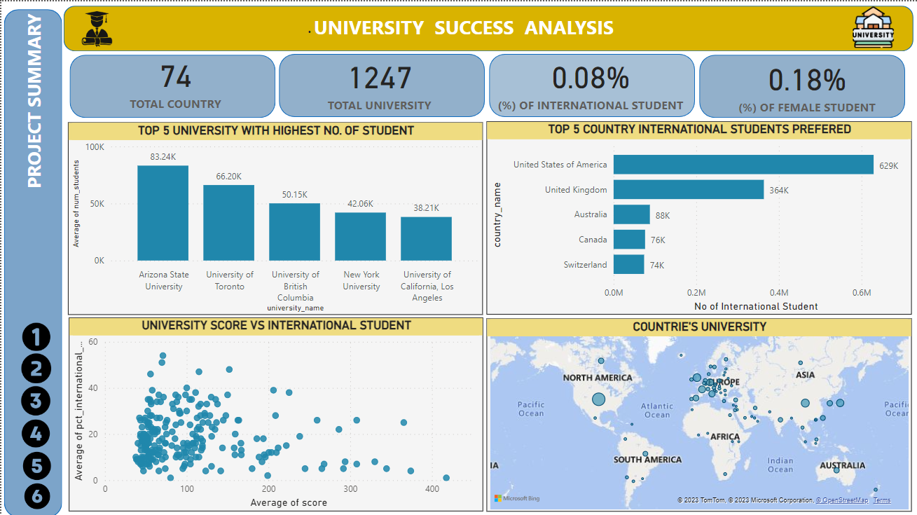
Power BI Problem Statement
DASHBOARD

Slide 13
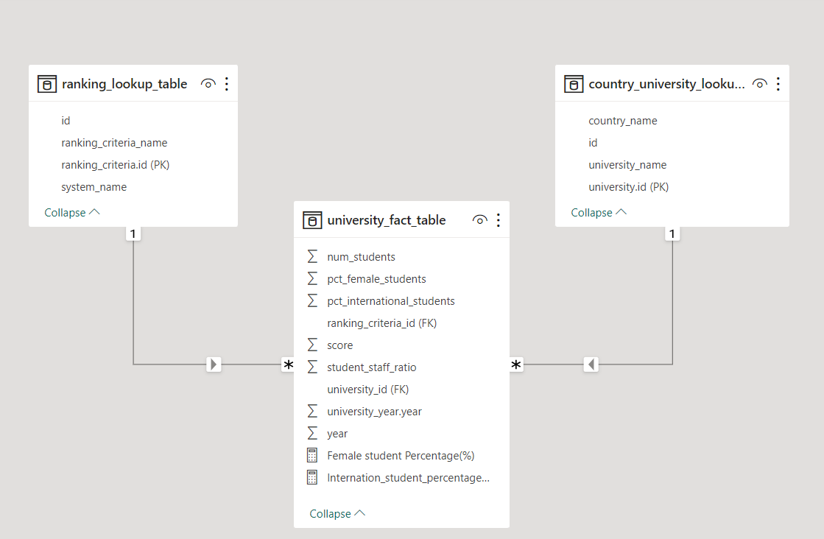
Power BI Data Model

Slide 14
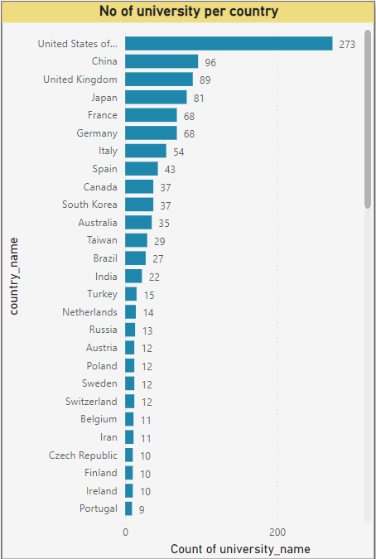
Q. How many universities are there in each country?

Slide 15
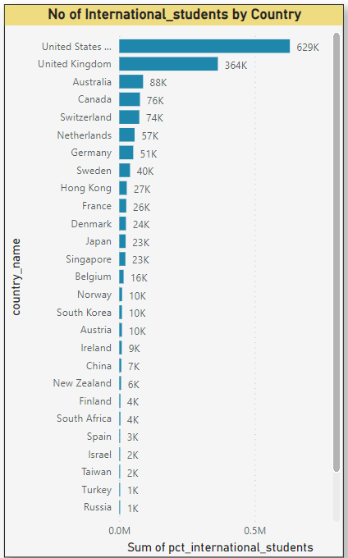
Q.2 ) What is the distribution of international students across different countries?

Slide 16
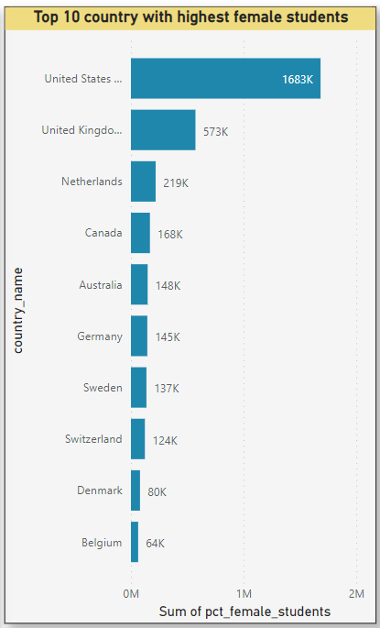
Q.3 ) Which country has the highest number of female students enrolled in universities?

Slide 17
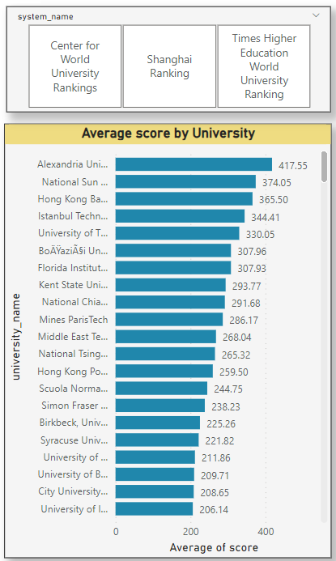
Q.4 ) What is the average score for universities according to each ranking system?

Slide 18
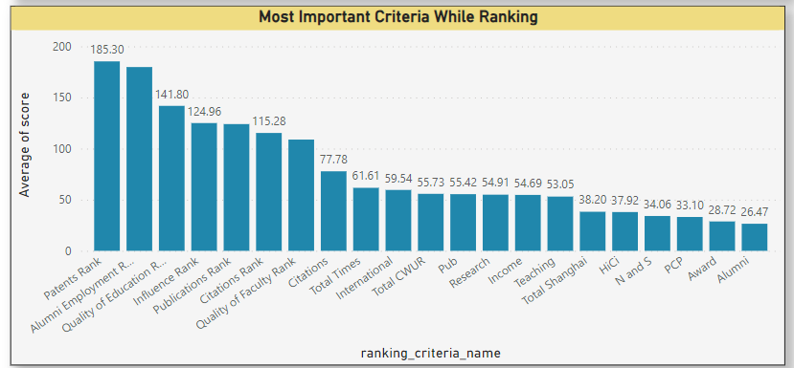
Q.6 ) What are the most important criteria considered by ranking systems?
We can see the Patents Rank, Alumni Employment Rate, Quality of Education are the most important criteria for Ranking.

Slide 19
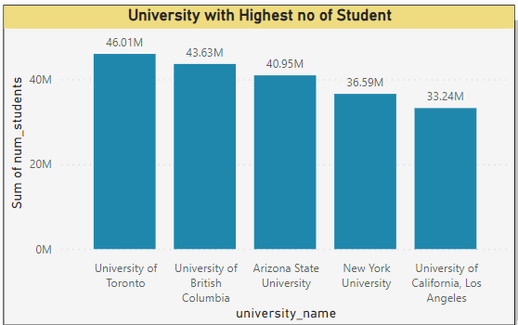
Q.9 ) Which university has the highest number of students?

Slide 20
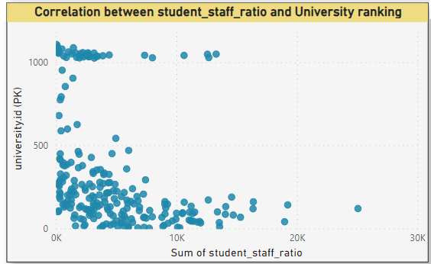
Q.11 ) Is there a correlation between a university's ranking and its student-staff ratio?
Conclusion: Here we can see that the higher rate of Student-staff ratio the better University Ranking

Slide 21
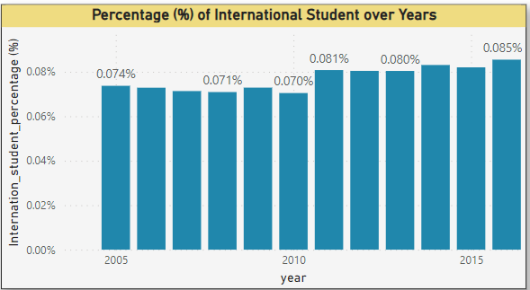
Q.14 ) How does the percentage of international students vary across different years?
Conclusion : Slowly international students percentage increased over years.

Slide 22
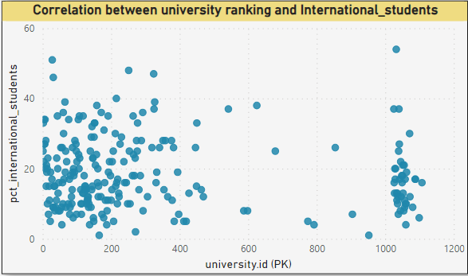
Q.15 ) What is the impact of a university's ranking on the number of international students it attracts?
Conclusion – Though numbers relation between university ranking and International students that not strong, but we can see that International student prefer better University Ranking Institute.

Slide 23

GitHub Link - Click Here
Project Video - Click Here
Thank You

